Slide 1


Banking in Bitcoin
Banking in Bitcoin

Slide 2

About Me
Associate Professor @Mays
Teach CSCE 489: Bitcoin Protocol
Teach ACCT 489: Accounting for Digital Transactions
No-Code Bitcoin class
korok@tamu.edu
Image: Bitcoin

Slide 3
Bitcoin has many innovations
A distributed network of nodes
An incentive system for miners to secure an immutable ledger
Programmable (e.g. MultiSig)
Scarce
Censorship resistant
Predictable and unchangeable issuance schedule
Image: Bitcoin

Slide 4
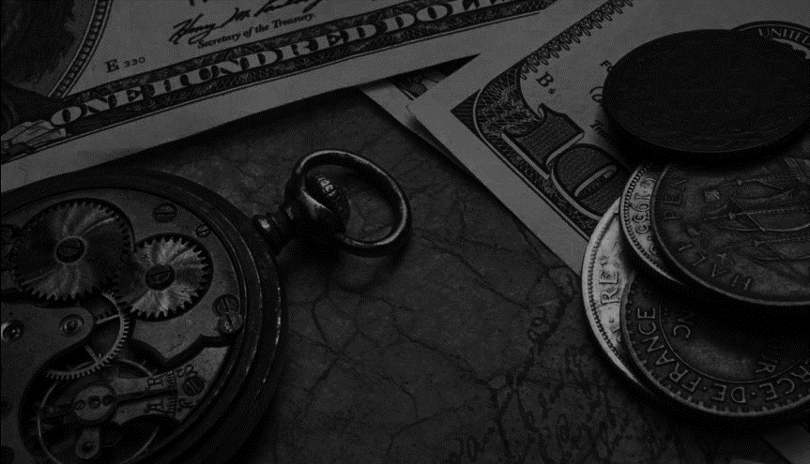
Sound Money
Barter
Gold and silver
Extraction cost
The edges of your quarter

Slide 5
The birth of fiat money
Banks storing Gold
Banks issuing Gold certificates
Trading Gold certificates
Banking Before the Civil War
The Suffolk Bank in Boston
The birth of the Federal Reserve
The Gold standard

Slide 6
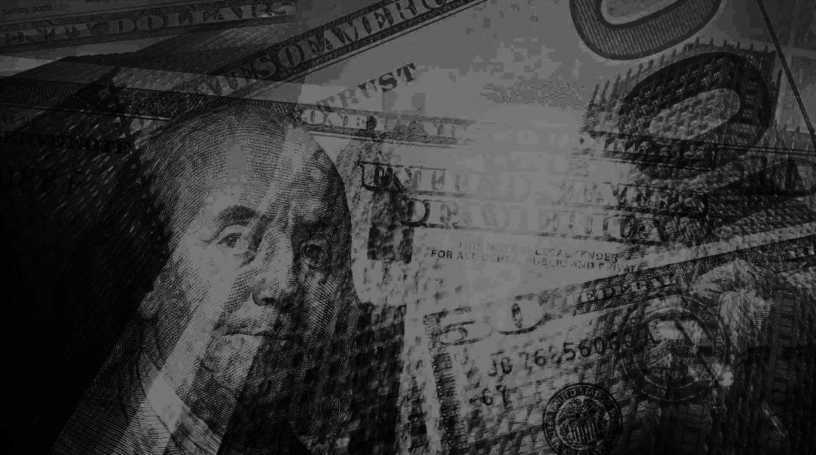
Money today
Deeply integrated with banks
Base money:
Currency plus bank reserves
Controlled by the Fed
Broad money
Demand deposits, time deposits, CDs, etc
Set by banks
The Fed makes base money, banks make broad money

Slide 7
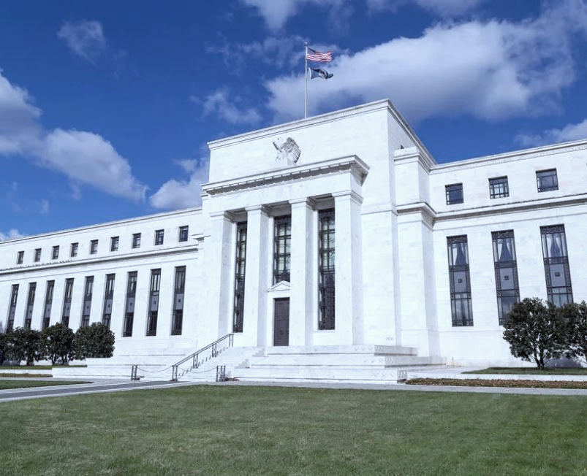

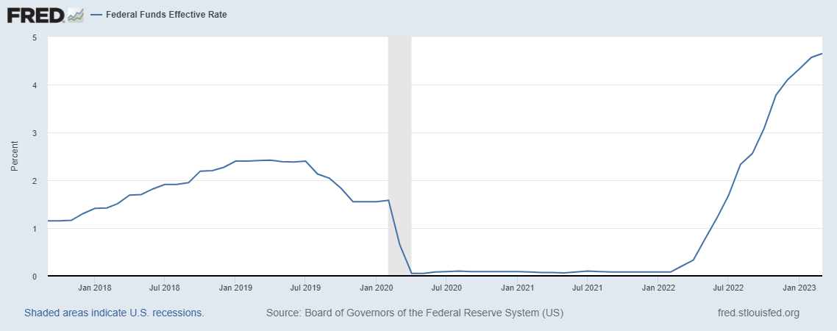
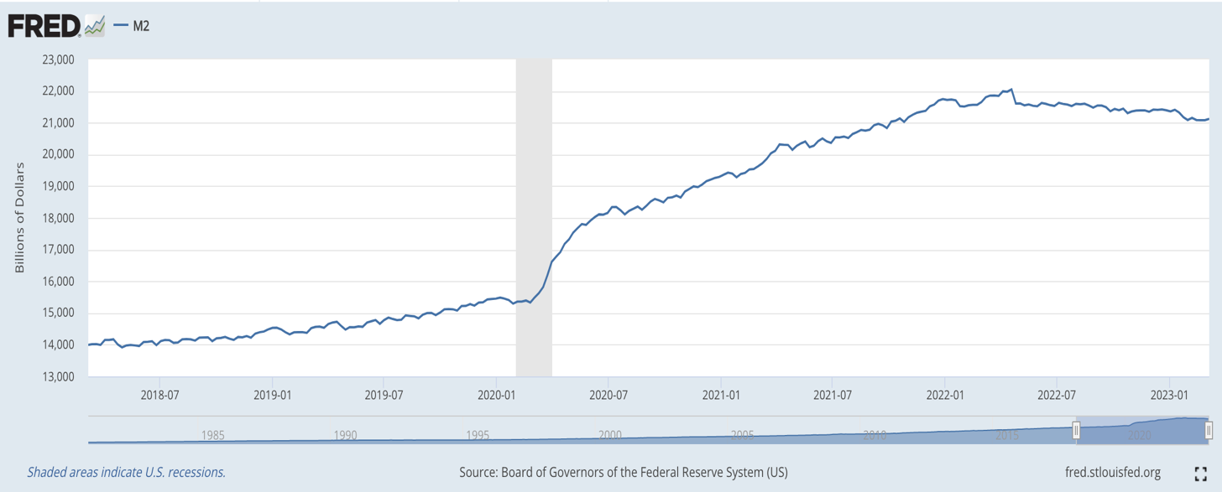

Slide 8
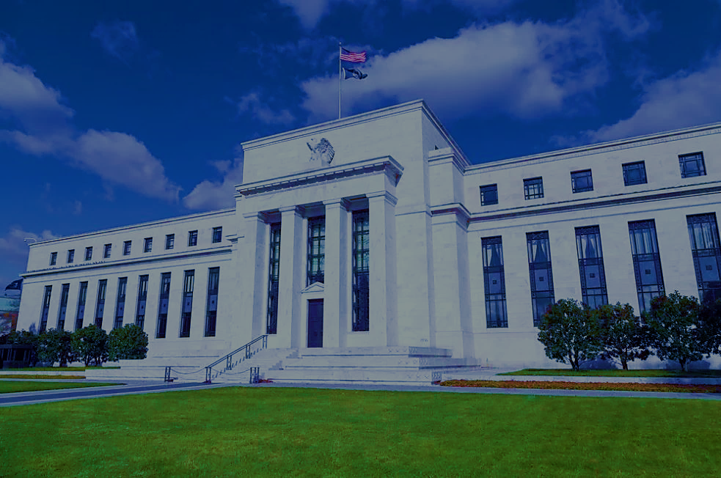
Breaking conventional wisdom
Only the Fed makes money
The Fed sets the interest rate
Money today is analog, not digital
Image: Federal Reserve Bank

Slide 9
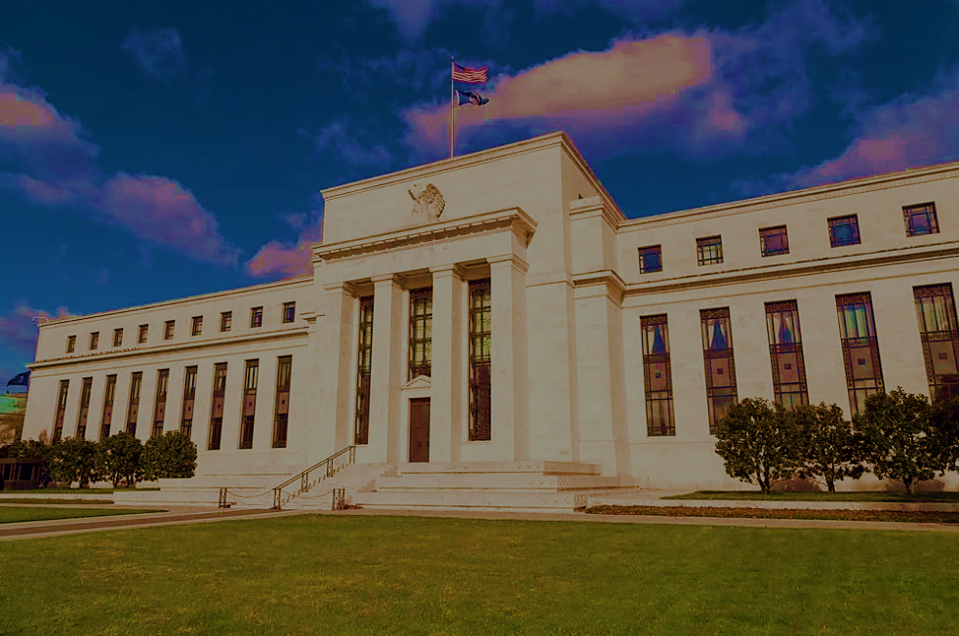
The case against central banks
The Hayek critique:
Central banking is central planning
Inducing moral hazard
Bailouts, deposit insurance
Rules vs. Discretion

Slide 10

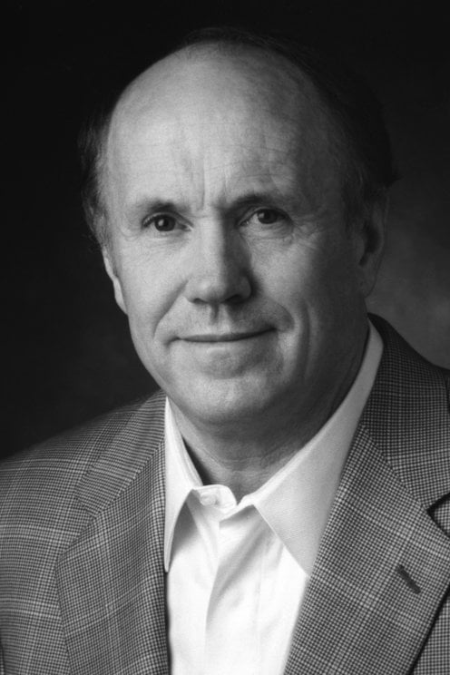
Finn Kydland
Ed Prescott

Slide 11

Building on a Floodplain

Slide 12


Slide 13
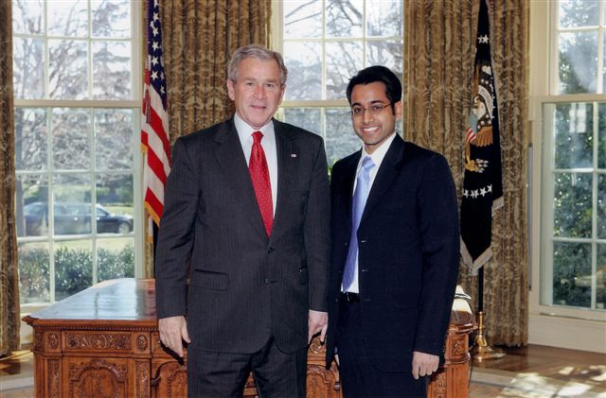

Slide 14
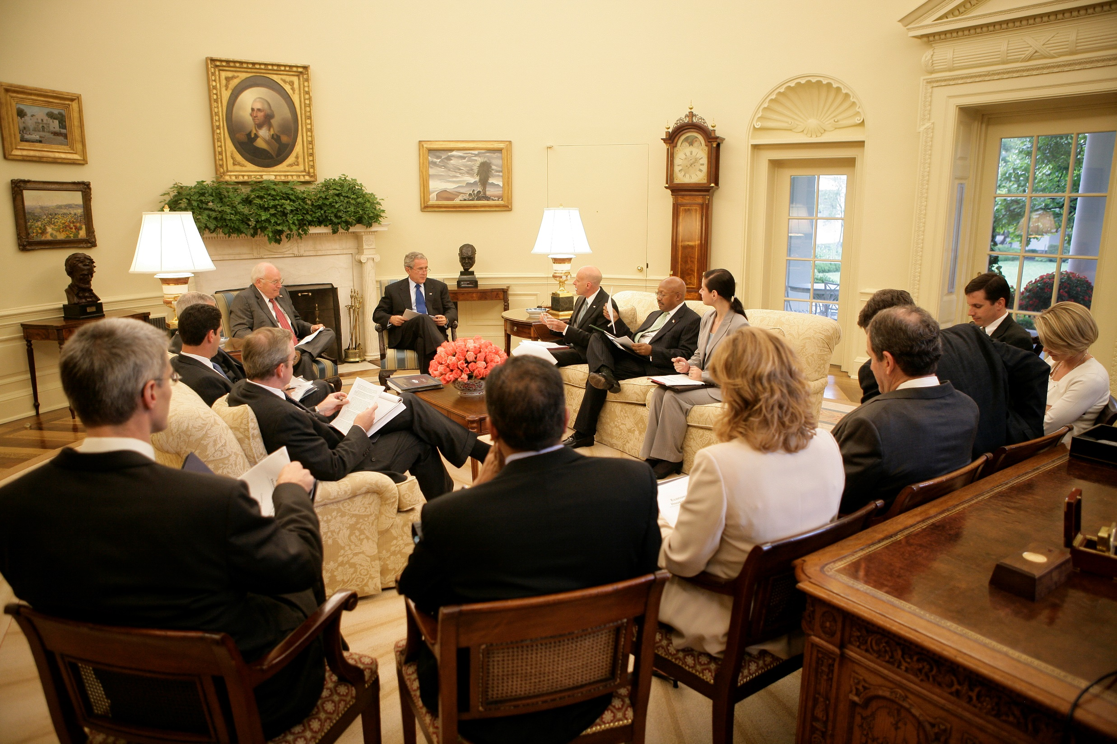

Slide 15


Slide 16


Slide 17
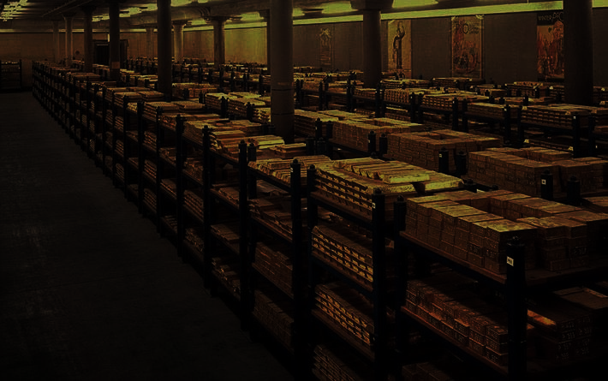
Enter Bitcoin
The Bitcoin issuance schedule
Predictable
Unchangeable
Image: Gold Inside Federal Reserve Bank

Slide 18
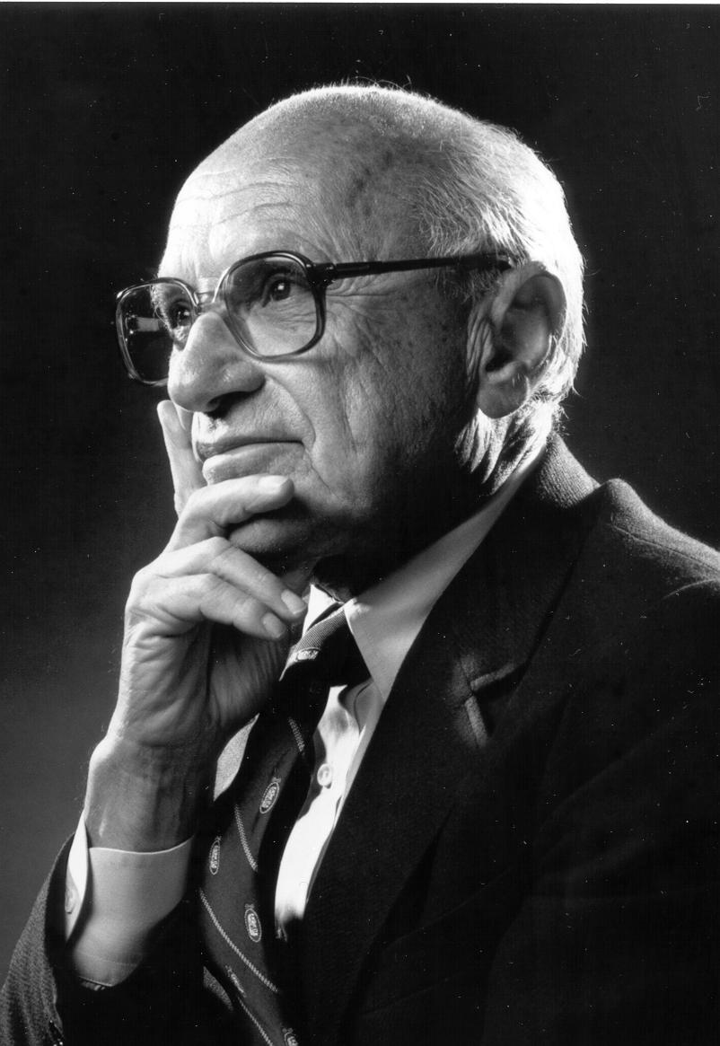

Slide 19
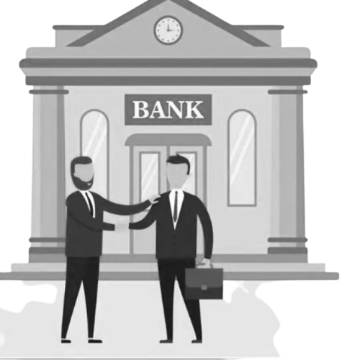
A new base layer
Bank to bank settlement
Secure, immutable, (slow)

Slide 20
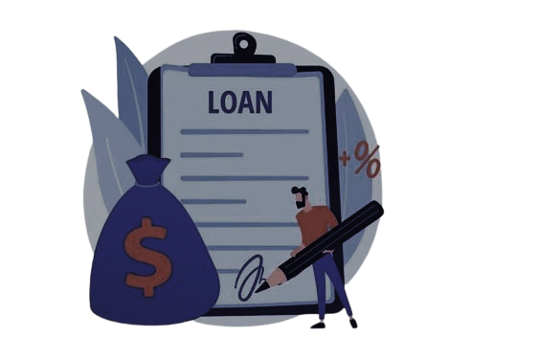
What are we missing?
Lending
The original deposit bank (full reserve)
The deposit lending bank (fractional reserve)
Bitcoin: be your own bank.

Slide 21

Banking in Bitcoin
Protocol issues base money (Bitcoin)
Banks still exist on a Bitcoin standard.
Take deposits in Bitcoin, lend in Bitcoin.
Operate without a central bank
Suspended convertibility contracts
Competition between banks
Private Sector Innovation

Slide 22
BitBank
Idea: Time Deposits
Deposit Bitcoin for duration X at rate Y
Penalty for early withdrawal
Banks balance deposits/loans
LOLR?
Deposit Insurance?

Slide 23
Staying in Touch
Teach CSCE 489: Bitcoin Protocol
Teach ACCT 489: Accounting for Digital Transactions
No-Code Bitcoin class
korok@tamu.edu
@KorokRay
PrinciplesofBTC.substack.com
Image: Bitcoin

